Slide 1
Learning objectives
HPC Server environment
Learn the basics of a HPC file architecture
Command-line
Understanding the Unix-like file system
Command line structure
File system navigation
Manipulating files and directories
Show important variable that determine facts about the system's config
Wildcards and expansion
Why the command-line?
Data management
Understanding BICB workflows and how to effectively organize, execute, and manage them
Discussion about software installation

Slide 2
Learning objectives
HPC Server environment
Learn the basics of a HPC file architecture
Command-line
Understanding the Unix-like file system
Command line structure
File system navigation
Manipulating files and directories
Show important variable that determine facts about the system's config
Wildcards and expansion
Why the command-line?
Data management
Understanding BICB workflows and how to effectively organize, execute, and manage them
Discussion about software installation

Slide 3
High Performance Computing

Slide 4

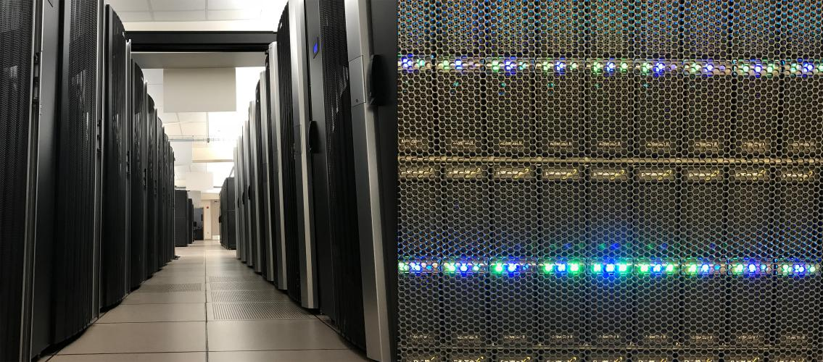
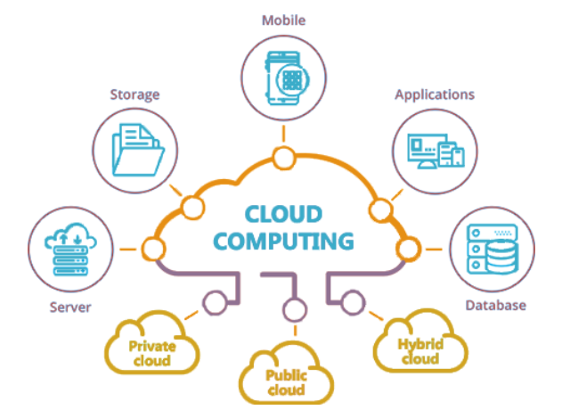
Local machine ↔ Remote Servers ↔ Cloud Computing

Slide 5
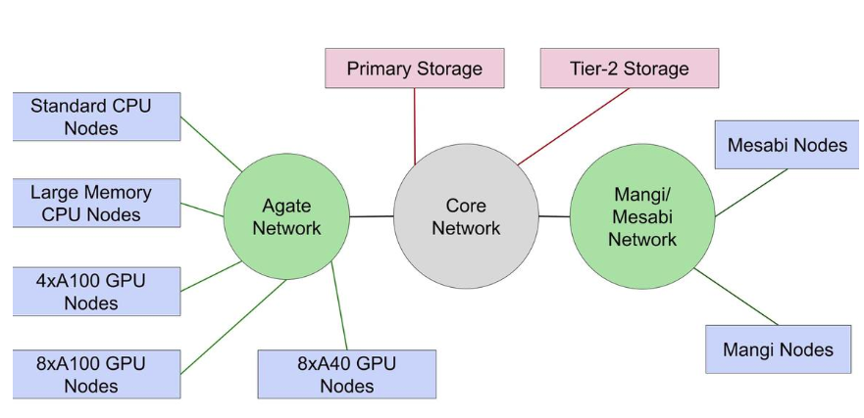
HPC topology

Slide 6
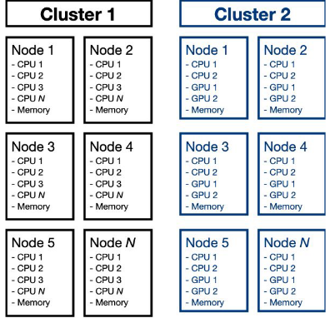

Slide 7
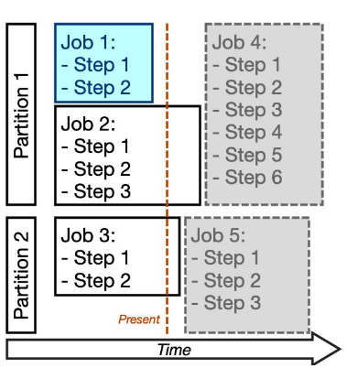

Slide 8
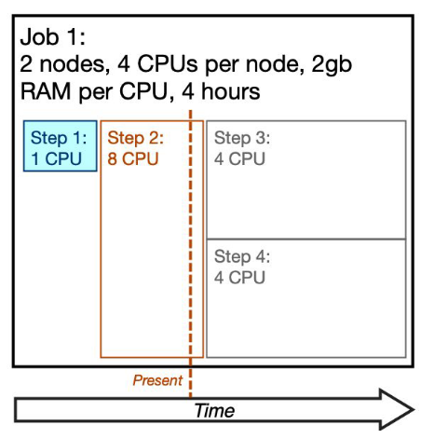

Slide 9
HPC Terminology
Cluster: Set of connected compute resources. Made up of multiple nodes.
Node: Physical machine that is part of the cluster. Multiple nodes are connected via network to make a cluster.
Core/CPU: Single processing unit for computing. One node contains many cores or CPUs (central processing unit). Cores, CPUs, and threads are terms in bioinformatics, which are often times synonymous with each other. Although a computer scientist could probably tell you the difference!
GPU: Graphics processing unit, specialized hardware that is designed to accelerate the rendering of graphics and parallel processing.
Partition: Queue where to run jobs. Has resource limits and access controls.
Job: A reservation on the system to run commands. Resource request that can be used to perform compute tasks. CPU (and optionally GPU), memory, disk space for a specified time.
Step: A specific command or compute task within a job. A job is made up of one or more steps.
Task: A compute process that needs to be run. One or more tasks make up a step.

Slide 10
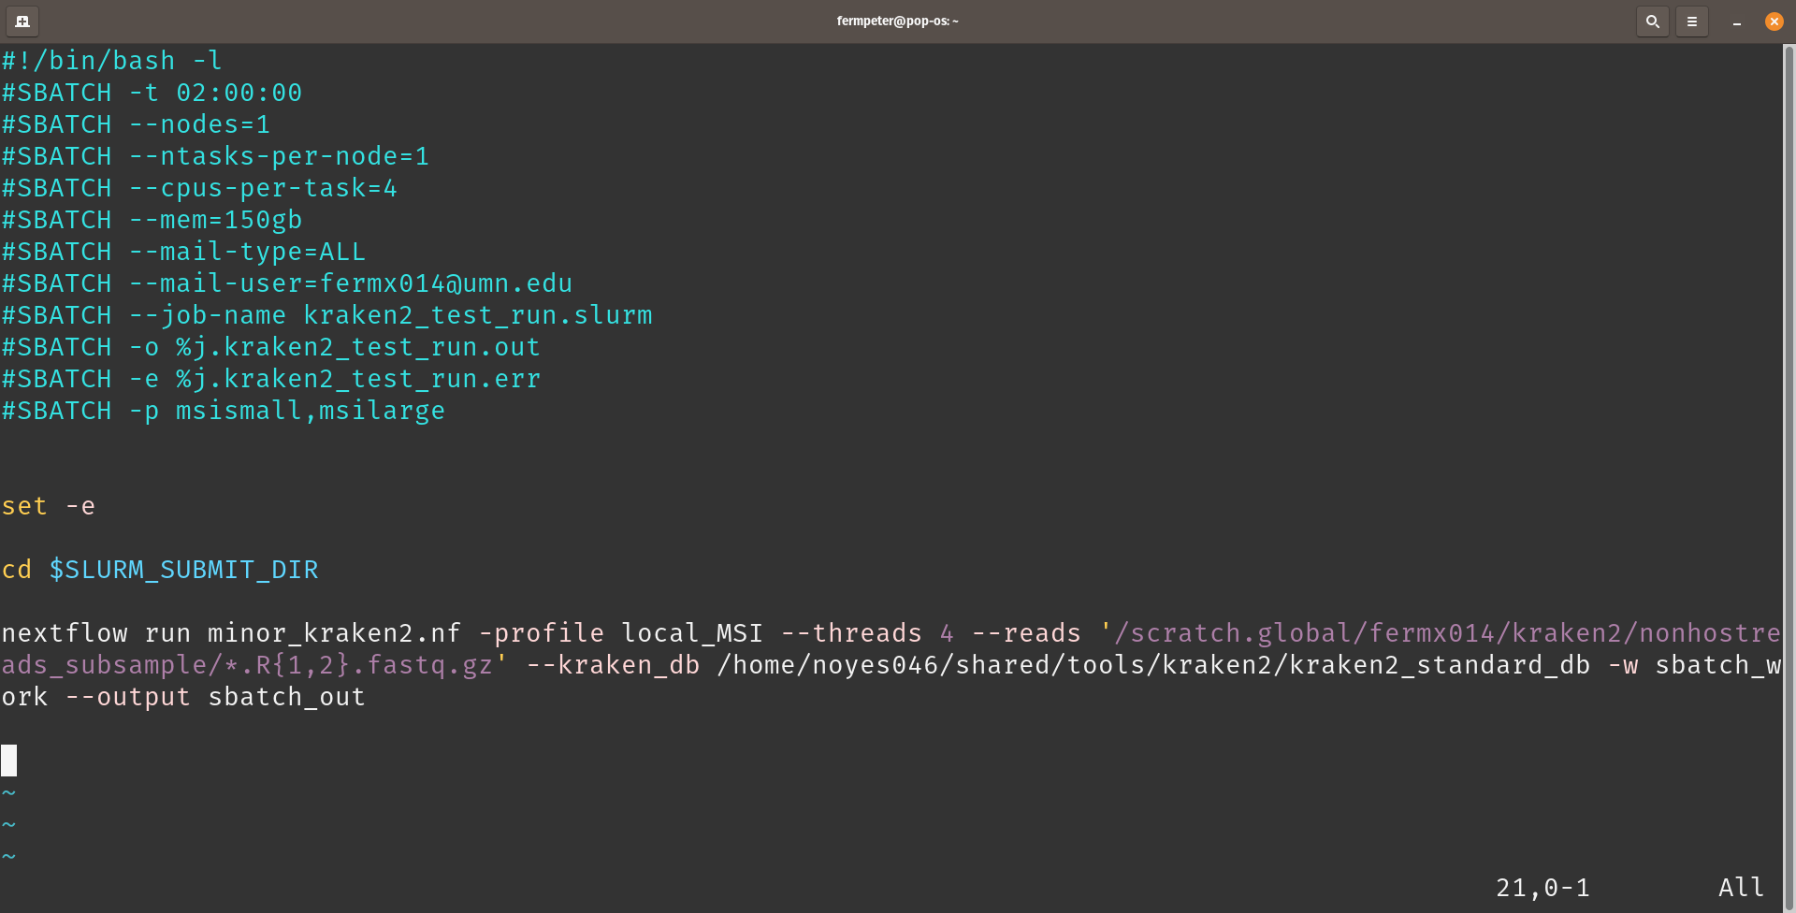
Batch Jobs

Slide 11
Command-Line

Slide 12
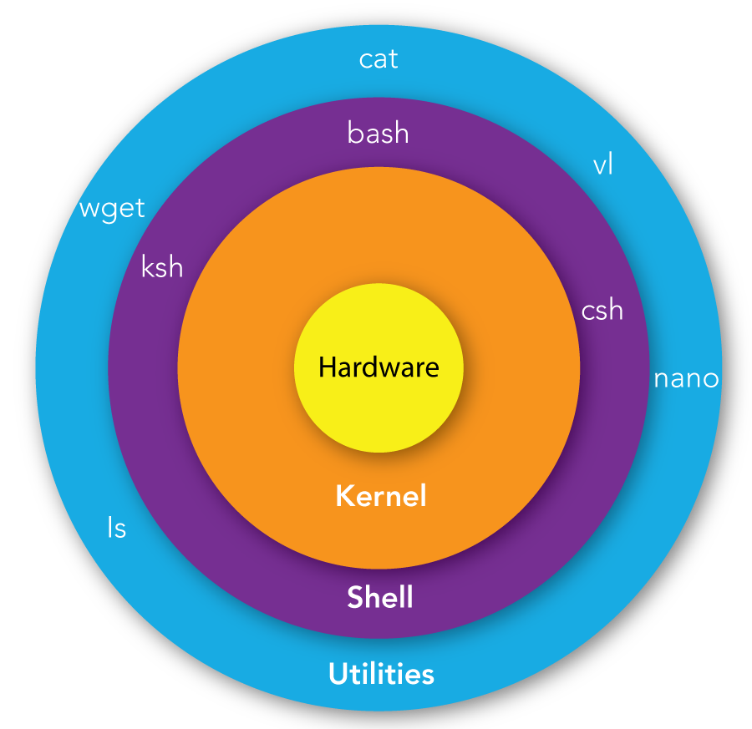

Slide 13
Command
Command <option(s)> <argument(s)>
Command: One of four things
An executable program
A command built into the shell itself
A shell function
An alias
option(s): Modify commands behavior.
Argument(s): The items upon which the command acts.

Slide 14
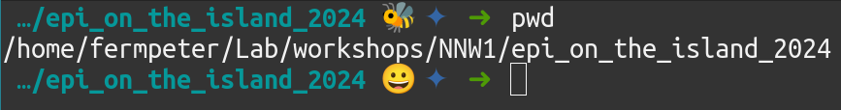
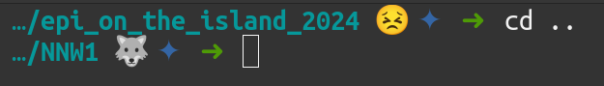
Pathnames
Absolute pathname:
Relative pathname:

Slide 15
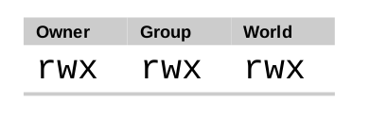
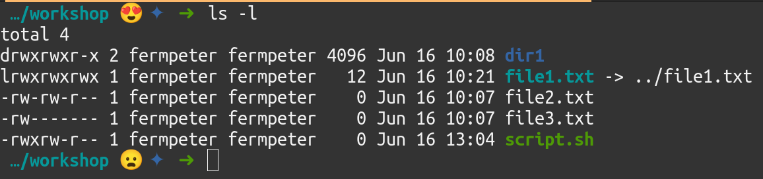
Permissions
r read
w write
x execute
- regular file
d directory
l symbolic link

Slide 16
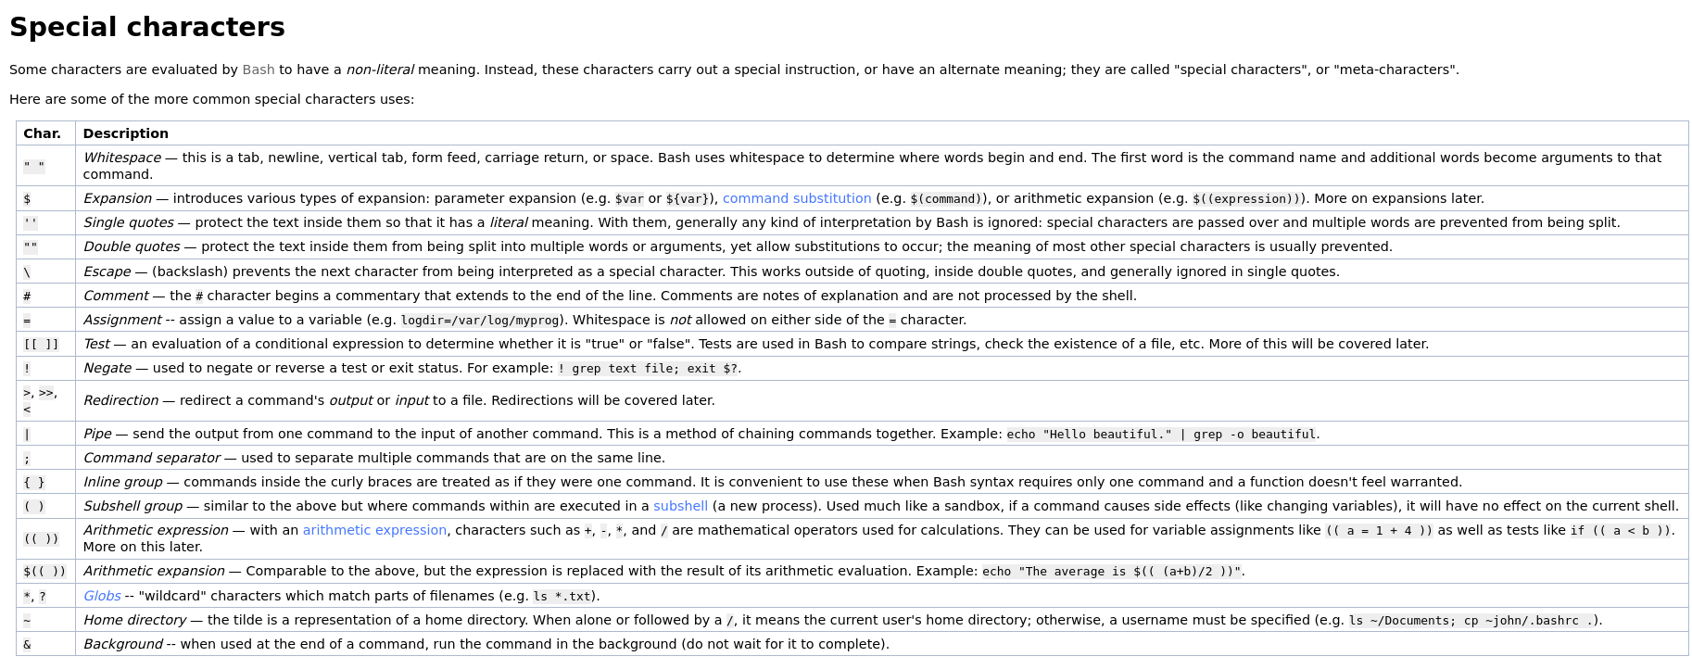
Bash special characters
BashGuide -- Special Characters

Slide 17

It's been said that “graphical user interfaces make easy tasks easy, while command line interfaces make difficult tasks possible”
The Linux Command Line
Fifth Internet Edition
- William Shotts

Slide 18
Data Management

Slide 19
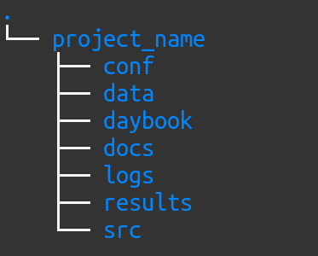

Project directory structure
It depends…

Slide 20
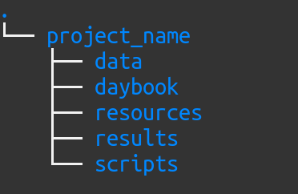
Project directory structure
It depends…

Slide 21
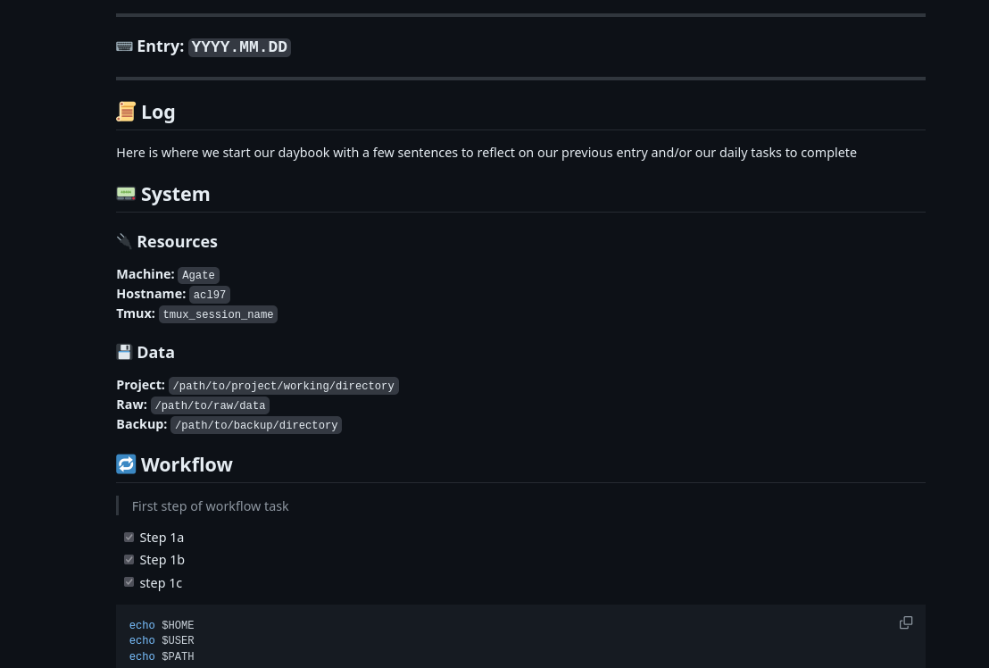
Lab notebook (daybook)

Slide 22









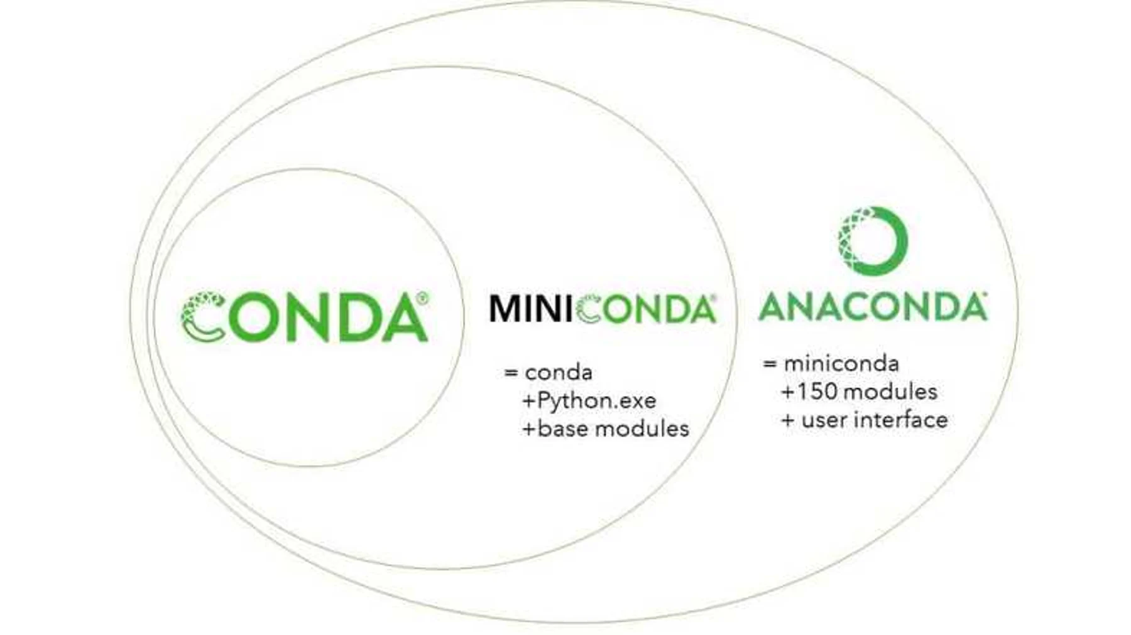





Software & Package managers

Slide 23
Server Navigation

Slide 24

Demo & Hands on

